Slide 1
STERLING
E-COMMERCE

Slide 2
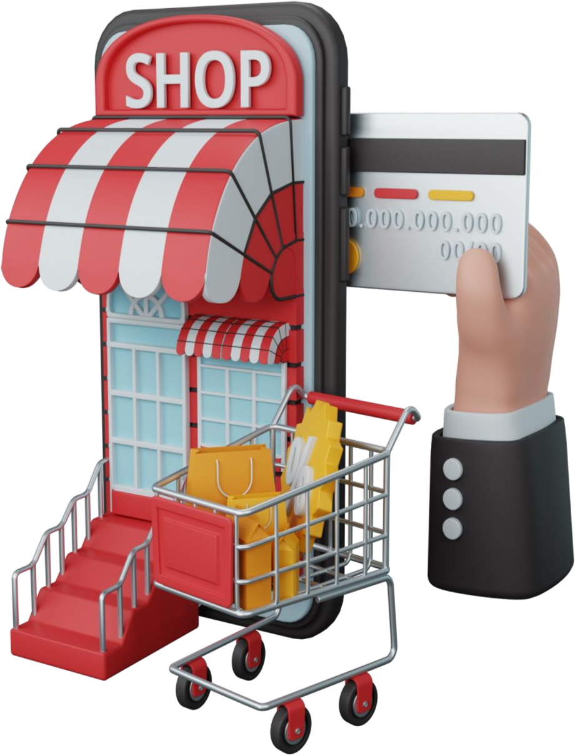
ABOUT US
Sterling E-Commerce is a one-stop online shopping destination for a wide range of high-quality products. Our mission is to provide our customers with the best shopping experience possible, with a focus on quality, affordability, and convenience.
At Sterling E-Commerce, we offer a wide selection of products across various categories such as health & sports, men's and women's fashion, computing, entertainment, mobiles & tablets, appliances, beauty & grooming, home & living, soghaat, school & education, books, and more. We pride ourselves on offering a comprehensive range of products that caters to the needs of our diverse customer base.
We are proud to be a leading e-commerce retailer, and we are committed to continuous innovation and improvement to meet the evolving needs of our customers.

Slide 3

PROBLEM OVERVIEW
The Director of Sterling contacted you and your team of Data Scientists because they are interested in leveraging the power of their data to gain insights into the business and improve their efficiency.
Sterling wants to better understand their customers' needs, preferences, and behavior. Specifically, want to identify any patterns or trends. Sterling believes that leveraging the power of data can help them make more informed decisions and boost effectiveness.
They want to understand their data, so they can optimize their product offerings, streamline operations, and enhance Sterling’s customer experience.

Slide 4

DATA DICTIONARY
Category – The category of goods
City – The city where customers are ordering from
County – The county where customers are ordering from
Cust Id – Customer ID
Customer Since – The date when the customer first order.
Date of Order – The date when the customer placed an order.
Full Name – Customer full name
Gender – (Male, Female)
Item Id – Item ID
Order Id – Order ID
Payment Method – The payment platform the customer used
Place Name – The exact location where the customer are ordering from
Ref Num – Reference Number
Region – The region where the customer are ordering from
State - The state where the customer are ordering from
User Name – The customer’s username
Zip – Customer’s zip code
Qty Ordered – The quantity of goods ordered
Total – Total amount paid by customer

